Slide 1
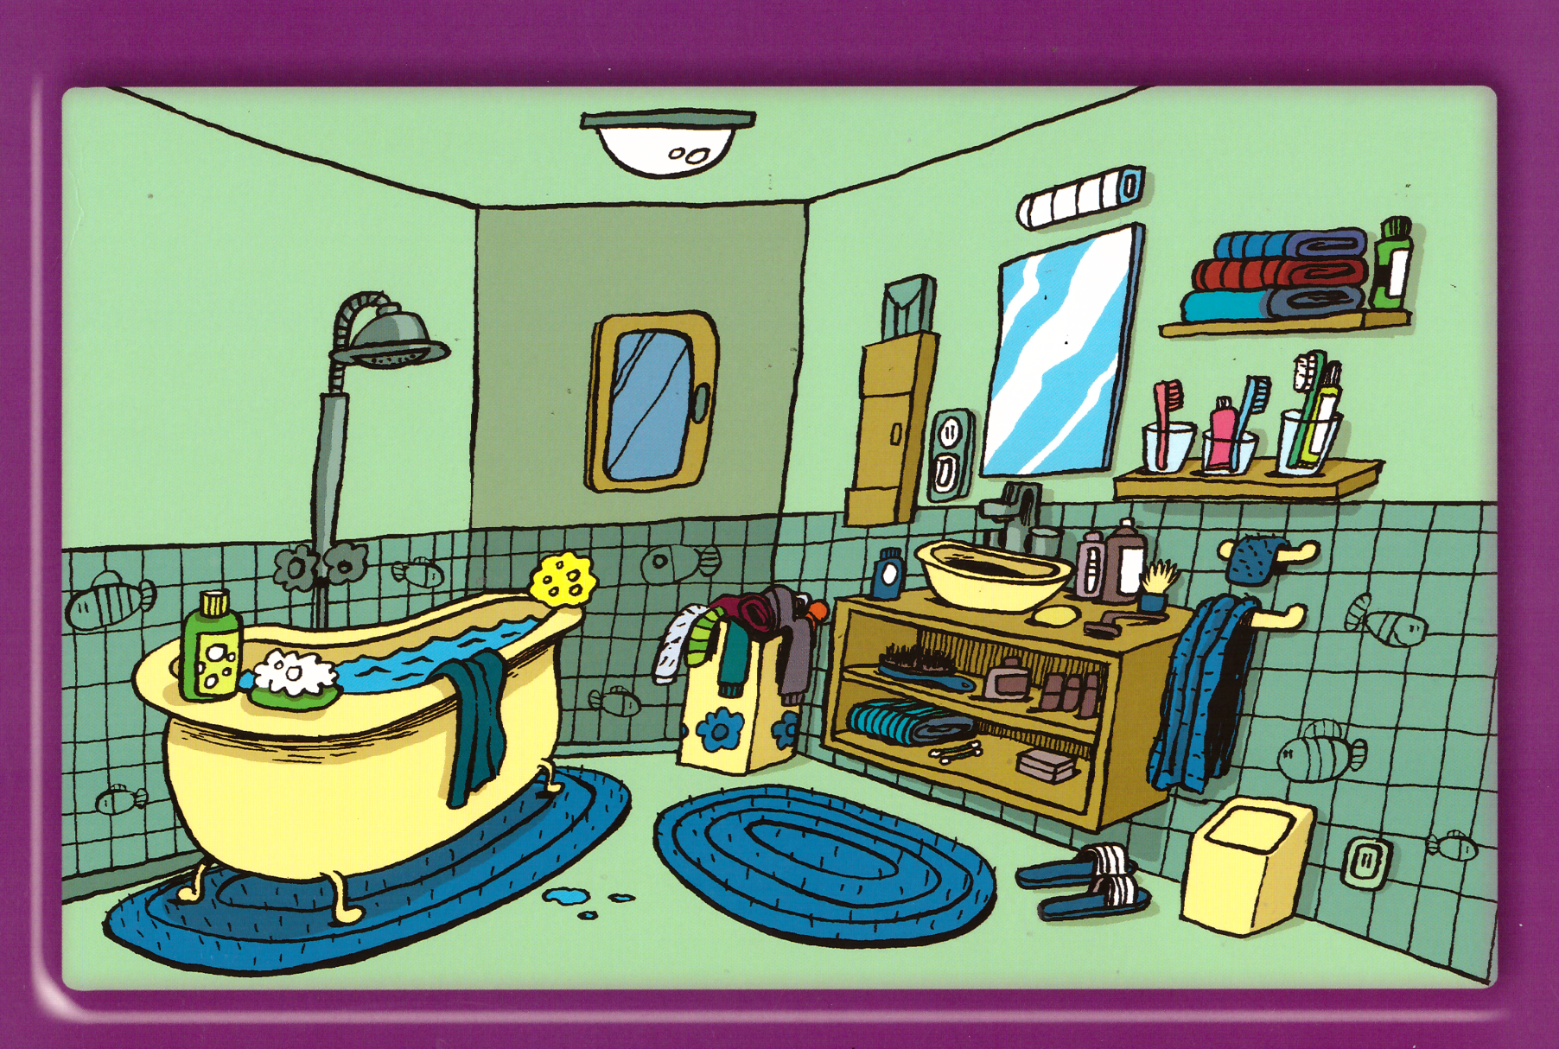
bathroom

Slide 2
house

Slide 3
Kitchen

Slide 4
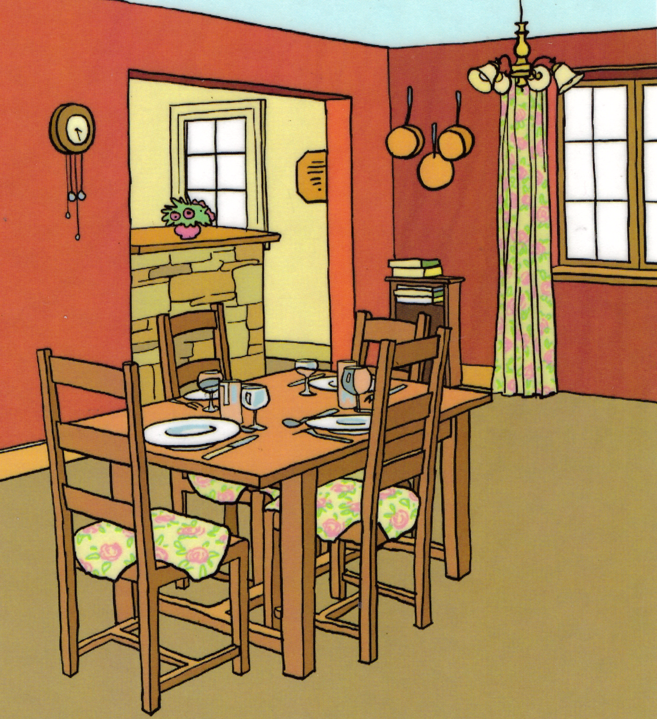
dining room

Slide 5
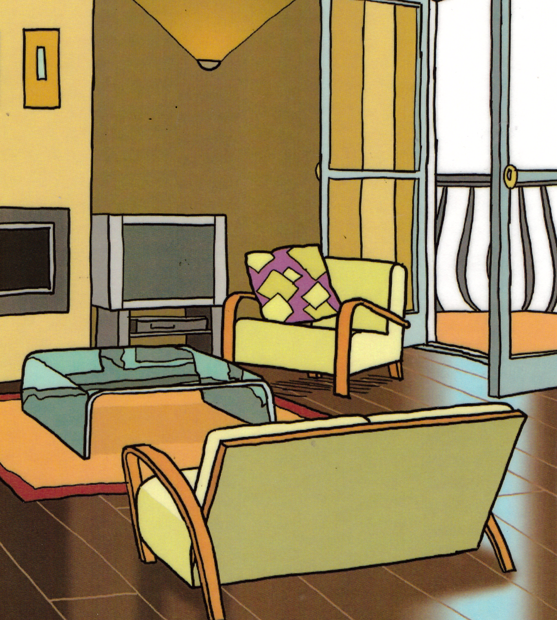
living room

Slide 6
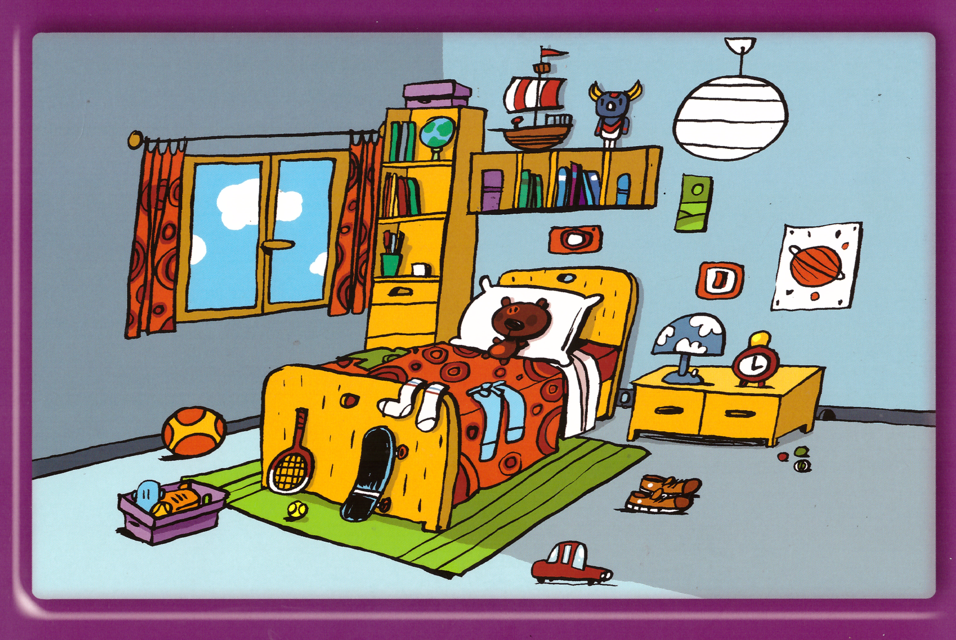
bedroom

